Slide 1
Chapter 24 – NOSQL Systems
CPSC 4620

Slide 2
Introduction
Developed to handle large amounts of data and more complicated data
Google, Amazon, Facebook, Twitter
Not Only SQL, not NO SQL
Need more than just Standard relational databases
Need to be able to handle more complex data, or less structured data
Sometimes SQL provides too many services
We don’t need the advanced querying and triggers
Existing DBMSs are designed to have them, and optimized for them
Adds in unnecessary overhead

Slide 3
Characteristics of Distributed NOSQL Systems
Scalability – Distributed system should be able to add more nodes as the data grows
Without interrupting the system that is running
Availability
System must always be available
Data must be replicated to allow this
Replicated data can lead to consistency issues
Improves read performance
Slows down write performance

Slide 4
Characteristics of Distributed NOSQL Systems
Replication models
Master-Slave
One copy is the master copy, others are duplicates
Write to Master copy, which will spread changes to the slave copies
Read from master, or from slave with no guarantee of accuracy
Master-Master
Every node is considered a Master
Read or Write on any node
Since users could write to the same data on two different nodes concurrently, you need a reconciliation method

Slide 5
Characteristics of Distributed NOSQL Systems
Sharding (horizontal partitioning) of files
Files/collection of objects
Can be millions of records
Can be accessed concurrently
Need to distribute across many nodes
Lightens the workload of each node
Makes consistency take a little more work
High Performance data access
Need to find individual records in millions of records
Hashing object key
Range partitioning on the object key
Keys in a range on the same node

Slide 6
NOSQL data model characteristics
No required schema
Self describing data
Semi-structured data
User can add a schema for efficiency
Less powerful query languages
CRUD
Create
Read
Update
Delete
Joins, advanced searching happens at application level
Versioning
Multiple version of the same data with timestamps

Slide 7
CAP Theorem
Describes competing requirements of a distributed database
Consistency
Is data consistent among replicated copies?
Availability
Is data available all the time?
Partition Tolerance
Can the database handle partitioning of nodes?
Nodes can’t communicate due to network issues
Impossible to guarantee all three
In order to keep data available even when partitioning occurs, we need redundant copies, which leads to consistency issues
NOSQL systems allow for reduced consistency
Called eventual consistency
The system is working on restoring consistency, delays are acceptable

Slide 8
Categories of NOSQL Systems
Document Based
Key-Value Based
Column Based (Wide Column)
Graph Based
Hybrid
Object databases and XML are sometimes considered NOSQL, although they existed before the term NOSQL was widely used

Slide 9
Document Based NOSQL
Store data as collections of similar documents
Documents could be object based, or XML
JSON (JavaScript Object Notation) is commonly used
Documents in a collection should be similar, but do not need to follow any schema
Variations are allowed
Documents have a unique ObjectID called _id
Documents describe some object or entity
Objects in a document can have other object types in them using:
Nesting/Embedding (like XML)
An array
References (like foreign keys)
MongoDB
CouchDB

Slide 10
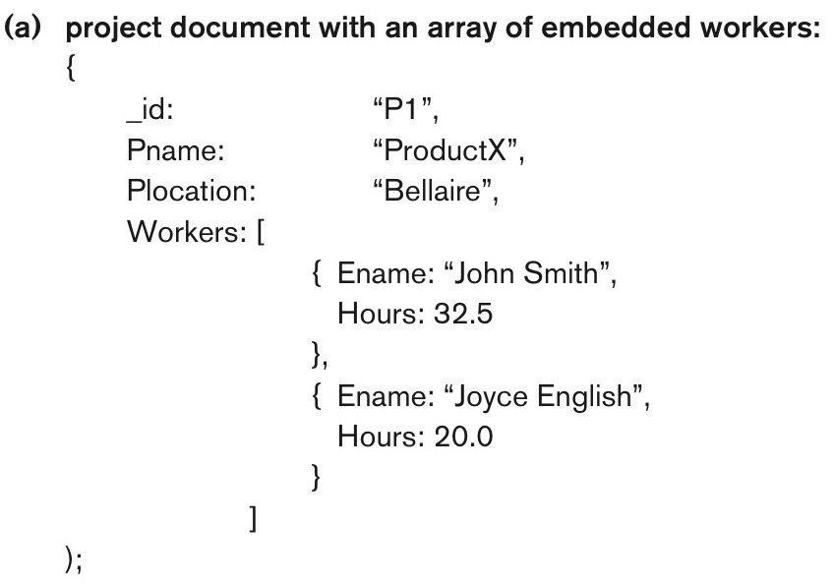
Figure 24.1a Example of simple documents in MongoDB. Denormalized document design with embedded subdocuments.
continued on next slide

Slide 11
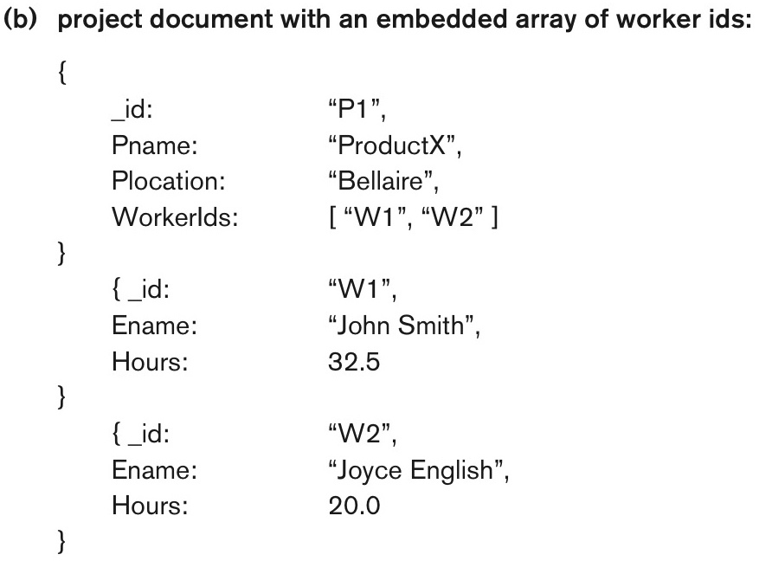
Figure 24.1b Example of simple documents in MongoDB. Embedded array of document references.
continued on next slide

Slide 12
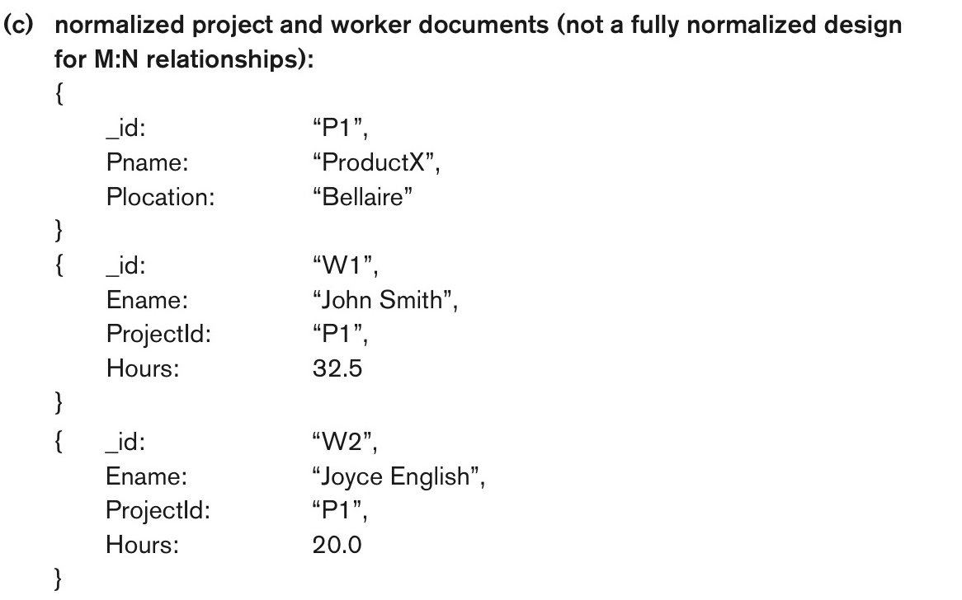
Figure 24.1c Example of simple documents in MongoDB. Normalized documents.
continued on next slide

Slide 13
Working with MongoDB
Commands are simple, just CRUD operations
Create -> insert
Db.<collection>.insert(<document(s)>)
Delete -> remove
Db.<collection>.remove(<condition>)
Read -> find
Db.<collection>.find(<condition>)
Update is still called update

Slide 14
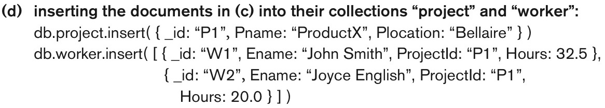
Figure 24.1d Example of simple documents in MongoDB. Inserting the documents in Figure 24.1(c) into their collections.

Slide 15
Key-Value NOSQL
Key is a unique identifier of some data
Value is the data itself (can be a collection)
Value must have a unique key
Retrieving a value by the key is very fast
No query language
A set of operations that can be used by application programmers
Basically a giant Map
DynamoDB
Voldemort Key-Value
Oracle key-value

Slide 16
Column Based Systems
Also known as Wide Column Systems
Examples:
BigTable
Developed and used by Google
Used to store large amounts of data, like in GMail
Hbase
Open Source is called Apache Hbase
Very similar to BigTable, just uses another storage system

Slide 17
Hbase Model
Namespaces
Tables
Column Families
Column Qualifiers
Columns
Rows
Data Cells
Timestamps/Versions

Slide 18
Hbase Columns
A Column consists of a Column Family and a Column Qualifier
Written as ColumnFamily:ColumnQualifier
For instance the Column Family name could have many qualifiers first_name, middle_name, last_name
EX. Sterling Mallory Archer
Name:first_name = “Sterling”
Name:middle_name = “Mallory”
Name:last_name = “Archer”
A succinct way to handle composite attributes

Slide 19
So... What’s the difference?
With Column-Based Systems, you only need to have the column families when you create the tables, not the column qualifiers.
A new column qualifier can be added at any time.
This allows flexibility

Slide 20
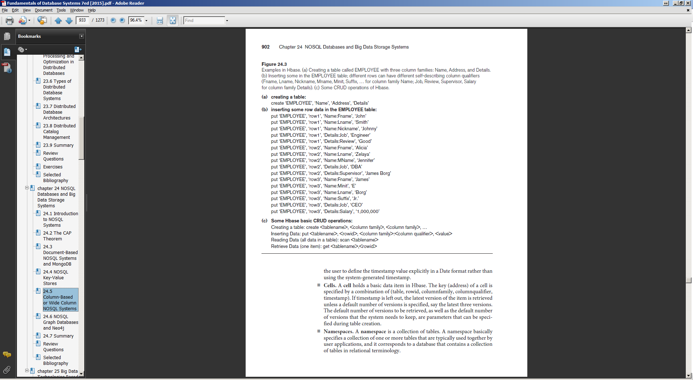
Example
EX. Sterling Mallory Archer
Name:first_name = ‘Sterling’
Name:middle_name = ‘Mallory’
Name:last_name = ‘Archer’
Name:code_name = ‘Duchess’

Slide 21
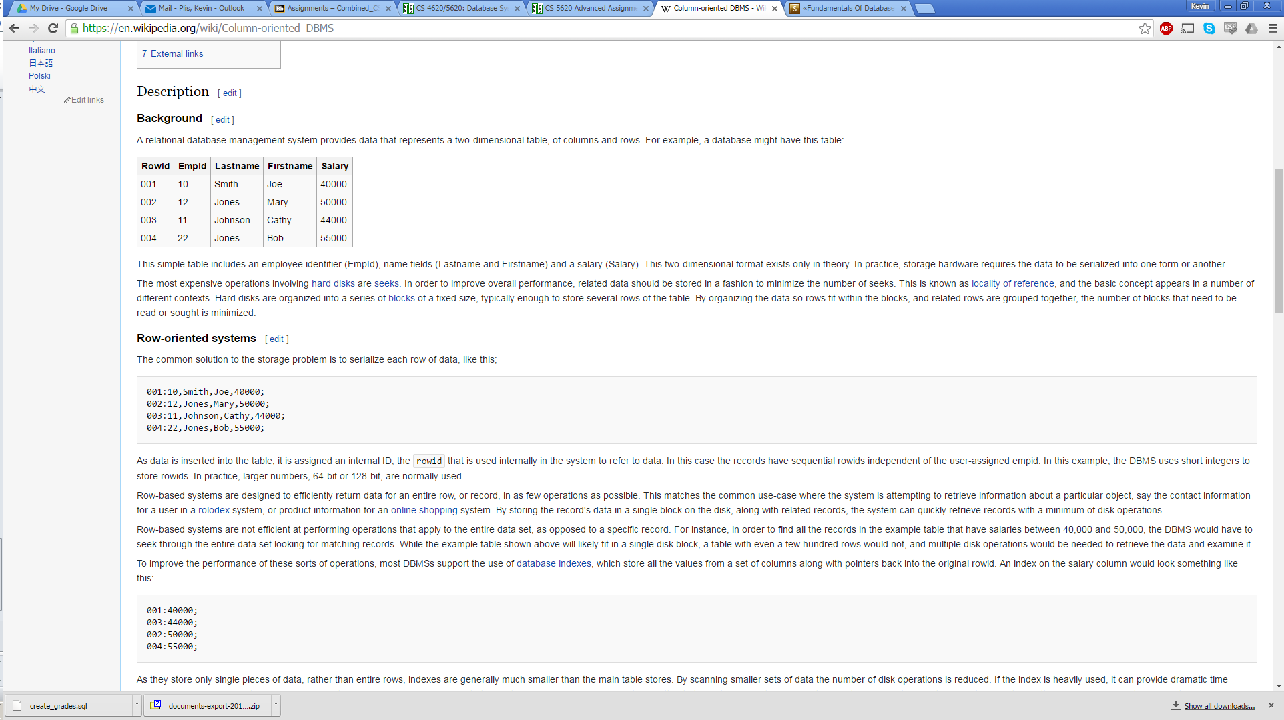
But Wait, There’s More!
Consider how the following data is stored on a disk:

Slide 22
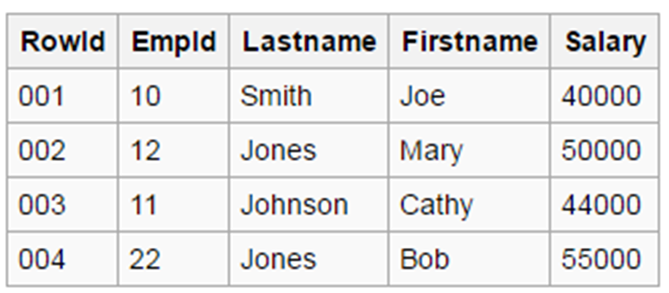
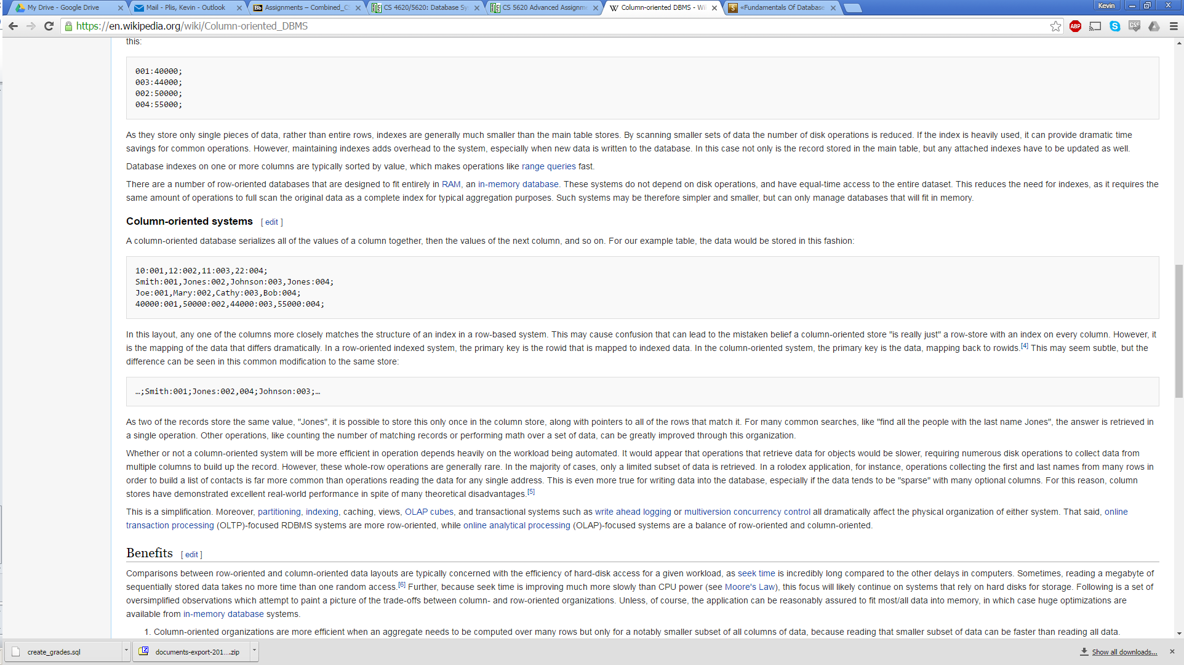
Stored on a disk

Slide 23
CRUD Operations
Create, Read, Update, Delete
Hbase only provides low level operations
Create: create a table
Put: insert data into a table
Scan: read whole table
Get: get one item from the table (search by row id/key)
All complex operations (joins, etc) must be done at the application level

Slide 24
Rows vs. Columns
Rows are better when...
Many columns of a single row are required at one time
All the data for a row is given at once
Columns are better when...
Aggregates are computed over many rows for a small number of columns
New values of a column are supplied at the same time

Slide 25
Graph Based NOSQL Systems
Neo4j is an open source example
Data is represented as a graph with vertices and edges
In the Neo4j model
Vertices are called Nodes which correspond to entities
Edges are relationships, which correspond to relationship instances
Relationships are directed
Nodes have a Label, which correspond to entity-types
Relationships have a Label, which corresponds to relationship types
Nodes and Relationships have Properties, which correspond to attributes
Properties can be grouped in a Map Pattern
{Fname:’Sterling’, Mname:’Mallory’, Lname:’Archer’}
Graph (Math) Term
Entity-Relationship Model Term
Graph Based NOSQL Term

Slide 26
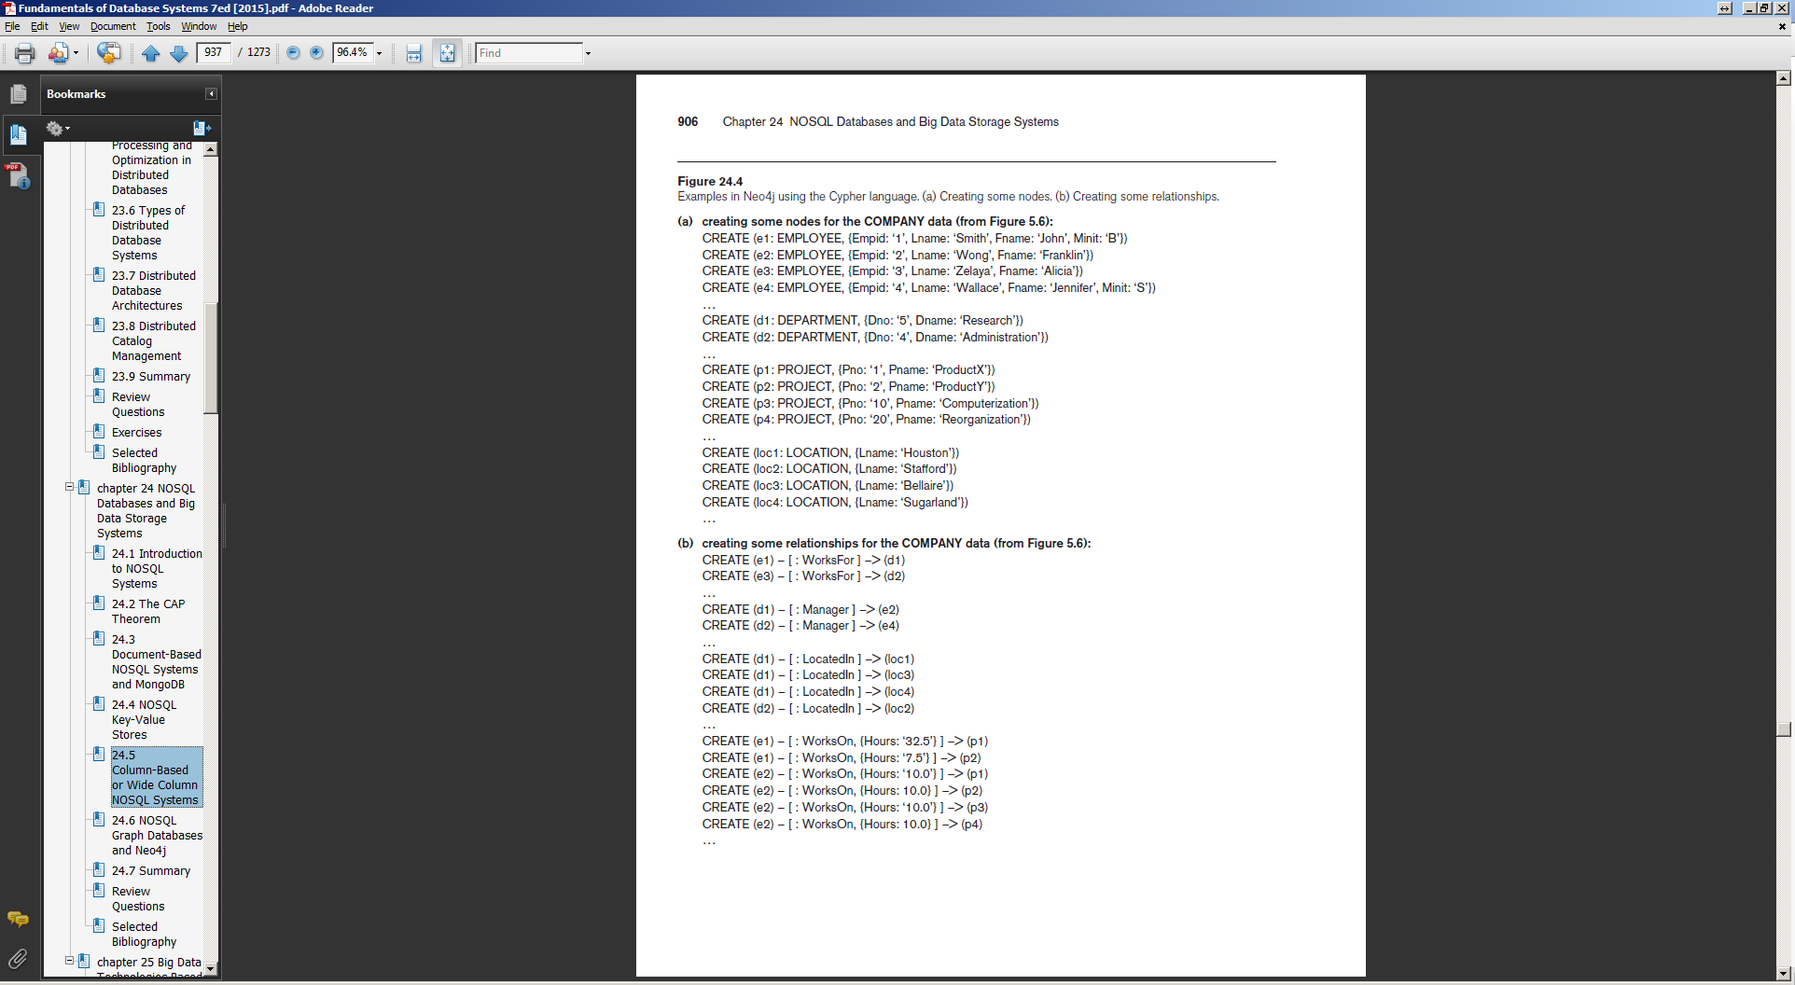
Properties
Nodes
Label
Label
Nodes
Relationships
Properties

Slide 27
Graph Based NOSQL Systems
Schemas are optional
Allow for adding property constraints based on their label
Cypher
High Level Query Language
Uses MATCH along with a relationship template to find matching nodes and relationships (Select)
Uses WHERE to specify which matches to consider
Uses RETURN to specify which properties to return (Project)
DELETE deletes a node or relationship
SET updates a node or relationship
REMOVE removes a property or label from a relationship

Slide 28
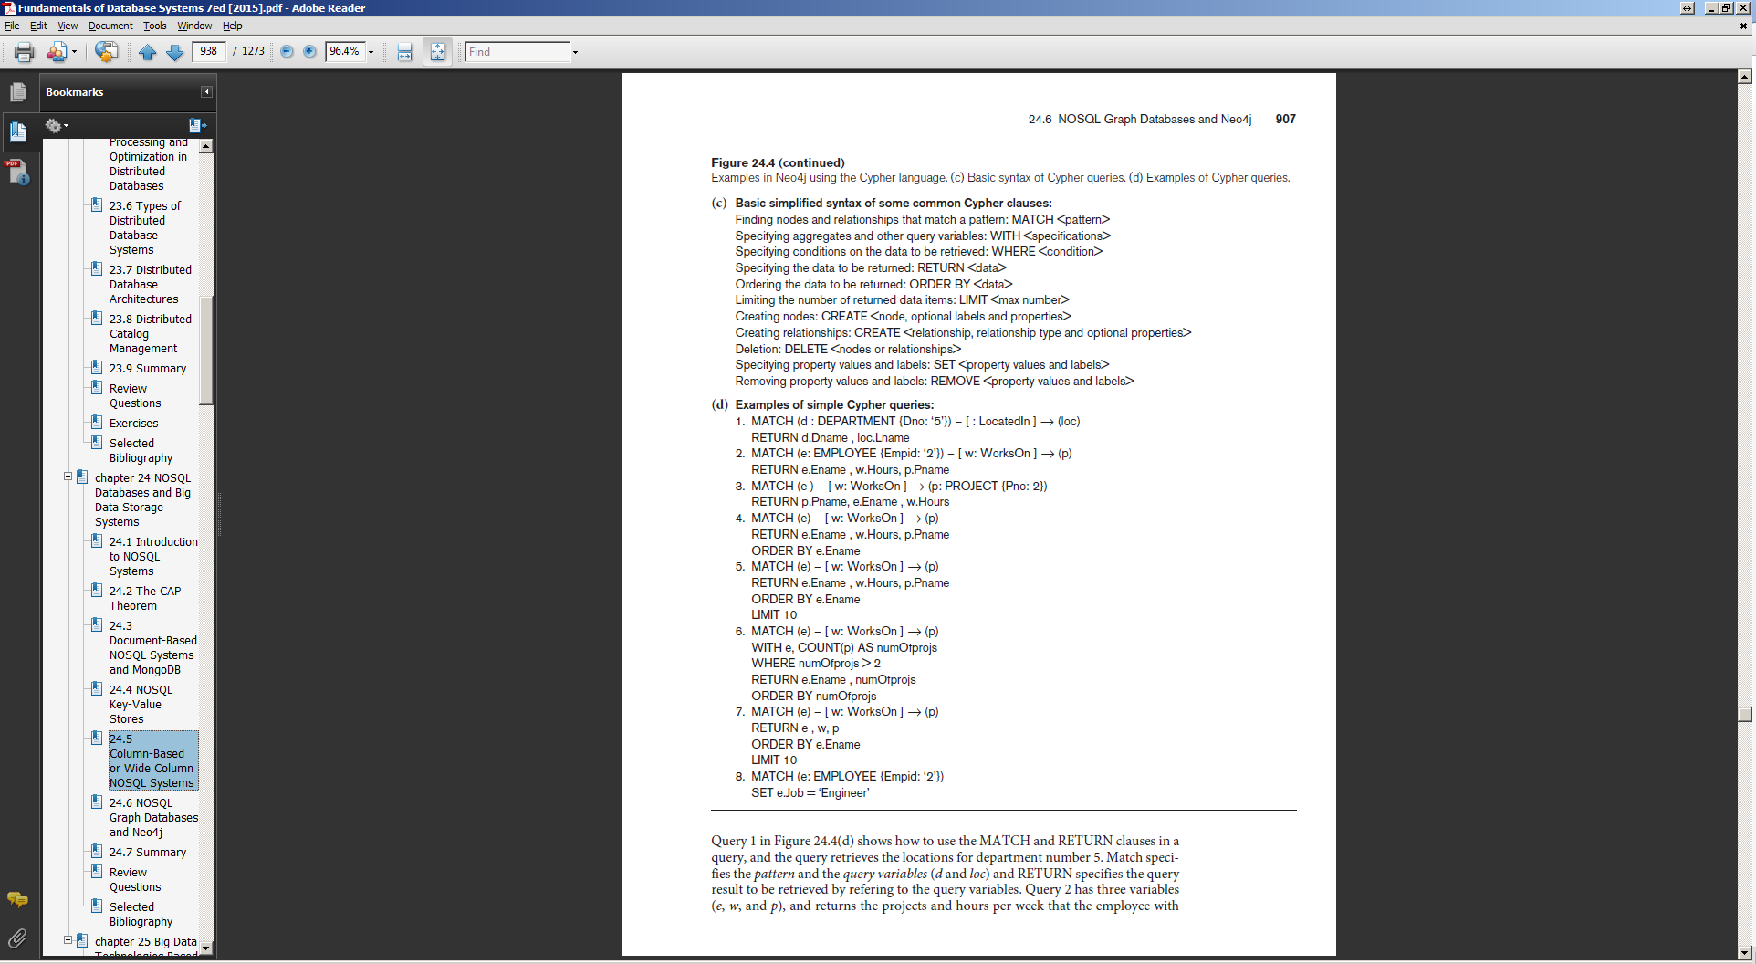
Cypher

Slide 29
Use Cases and Advantages
Advantages
Real time analysis of data that elegantly captures relationships
Can use Graph Searching algorithms
Reflects real life relationships and complexities
Use Cases
Recommendation Systems
Social Networks
Fraud Detection

Slide 30
Summary
These may seem like limited versions of a relational database
Because they are
Less functionality means more optimization
Can handle big data
Less functionality means more flexibility
Can add attributes on the fly
Semi-Structured data
Handle multimedia data

